Slide 1
Data Preprocessing
Noble Xavier

Slide 2
Data Preprocessing
Pre-processing refers to the transformations applied to our data before feeding it to the algorithm.
Data preprocessing is a technique that is used to convert the raw data into a clean data set. Other words whenever the data is gathered from different sources it is collected in raw format which is not feasible for the analysis.

Slide 3
Handling Null Values (dropna())
There are various ways for us to handle this problem. The easiest way to solve this problem is by dropping the rows or columns that contain null values.
dropna() takes various parameters like:
  axis — We can specify axis=0 if we want to remove the rows and axis=1 if we want to remove the columns.
  how — If we specify how = ‘all’ then the rows and columns will only be dropped if all the values are NaN.By default how is set to ‘any’.
  thresh — It determines the threshold value so if we specify thresh=5 then the rows having less than 5 real values will be dropped.
  subset —If we have 4 columns A, B, C and D then if we specify subset=[‘C’] then only the rows that have their C value as NaN will be removed.
  inplace — By default, no changes will be made to your dataframe. So if you want these changes to reflect onto your dataframe then you need to use inplace = True.

Slide 4
Data Preprocessing Steps
Import relevant libraries
Import the Data Set to analyse and clean for prediction
Missing value treatment(Impute the dataset)
  In numerical data
    Populate with mean –When there is no outlier
    Populate with median – When there is the outlier
  Categorical data– Mode imputation – Maximum data category

Slide 5
Data Preprocessing Steps
Encoding
  Label Encoding – Convert to number
  One hot Encoding – Create multiple columns based on the number of unique values
Feature Scaling:
  Feature Scaling is transforming the range of features to a standardized scale, preventing certain features from dominating due to their inherent scale.
  Standardization – When there is no outlier
  Normalization/ Min Max Scaler – When there is an outlier

Slide 6
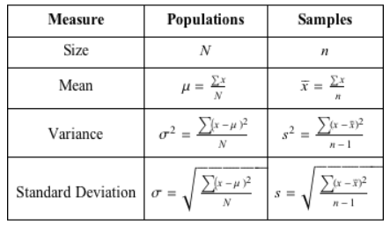
Basic Formulas

Slide 7
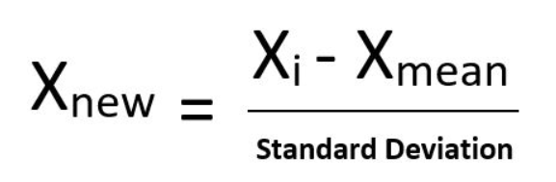
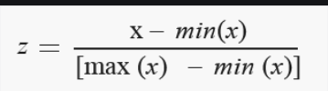
Basic Formulas
Min Max Scaler
Standardization

Slide 8
